Slide 1
Machine learning: Methods and Tools
Wolfgang Ecker, Elena Zennaro, Lorenzo Servadei

Slide 2
The Learning Theory
Wolfgang Ecker, Elena Zennaro, Lorenzo Servadei

Slide 3
Agenda: The Learning Theory
The Learning Problem
Is Learning Feasible
Error and Noise
Theory of Generalization
The VC Dimension
Bias-Variance Tradeoff
Overfitting

Slide 4
Predict how a viewer will rate a movie
The essence of Machine Learning:
A pattern exists.
We cannot pin it down mathematically.
We have data on it.

Slide 5

The Components of Learning
Metaphor: Credit approval
Applicant information:
age gender
annual salary years in residence years in job
current debt
·· ·
23 years male
$30,000
1 year
1 year
$15,000
·· ·
Approve credit?

Slide 6
The Components of Learning
Formalization:
Input: x
(customer application)
Output: y (good/bad customer? )
Target function: f: X → Y (ideal credit approval formula)
Data:(x₁, y₁), (x₂, y₂), · · · , (x_{N} , y_{N} ) (historical rec ords)
↓ ↓ ↓
Hypothesis: g : X → Y (formula to be used )

Slide 7
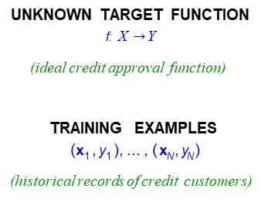
The Components of Learning
UNKNOWN TARGET FUNCTION
f: X $→$ Y
(ideal credit approval function)
TRAINING EXAMPLES
(x₁ , y₁ ), ... , ( x_{N} , y_{N} )
(historical records of credit customers)
LEARNING ALGORITHM A
FINAL HYPOTHESIS
g ≈ f
(final credit approval formula)
HYPOTHESIS SET
H
(set of candidate formulas)
§

Slide 8
Solution Components
The 2 solution components of the learning problem:
UNKNOWN TARGET FUNCTION
f: X Y
(ideal credit approval function)
The Hypothesis Set
H = {h} g ∈ H
The Learning Algorithm
TRAINING EXAMPLES
(x₁ , y₁ ), ... , ( x_{N} , y_{N} )
(historical records of credit customers)
LEARNING ALGORITHM A
FINAL HYPOTHESIS
g ~ f
(final credit approval formula)
HYPOTHESIS SET
H
Together, they are referred to as the learning model
(set of candidate formulas)

Slide 9
For input x = (x₁, · · · , x_{d}) 'attributes of a customer'
A simple Hypotesis Set – the Perceptron
d
Σ
Approve credit if w_{i}x_{i} > threshold,
i=1
d
Σ
Deny credit if w_{i}x_{i} < threshold.
i=1
This linear formula h ∈ H can be written as
d
Σ
− threshold
h(x) = sign w x
i i
i=1
§

Slide 10
A simple Hypotesis Set – the Perceptron
d
Σ
−
h(x) = sign w x
w0
i i
i=1
Introduce an artificial coordinate
x₀ = 1:
_
_
+
+
_
+
_
+
+
+
d
_
+
_
+
Σ
h(x) = sign w x
i i
_
+
_
+
i=0
In vector form, the perceptron implements:
`linearly separable' data
h(x) = sign (w^{T}x)
Notes:
here

Slide 11








A simple learning Algorithm – the PLA
The perceptron implements
h(x) = sign(w^{T}x)
y= +1
w+y x
Given the training set:
(x₁, y₁), (x₂, y₂), · · · , (x_{N} , y_{N})
x
w
pick a misclassified point:
sign(w^{T}x_{n}) ≠ y_{n}
y= -1
w
and update the weight vector:
x
w+y x
w ← w + y_{n}x_{n}

Slide 12



Iterations of the PLA
One iteration of the PLA:
w ← w + yx
where (x, y) is a misclassified training point.
_
+
_
+
At iteration t = 1, 2, 3, · · · , pick a misclassified point from
(x₁, y₁), (x₂, y₂), · · · , (x_{N} , y_{N} )
and run a PLA iteration on it.
+
_
+
+
_
That's it!

Slide 13
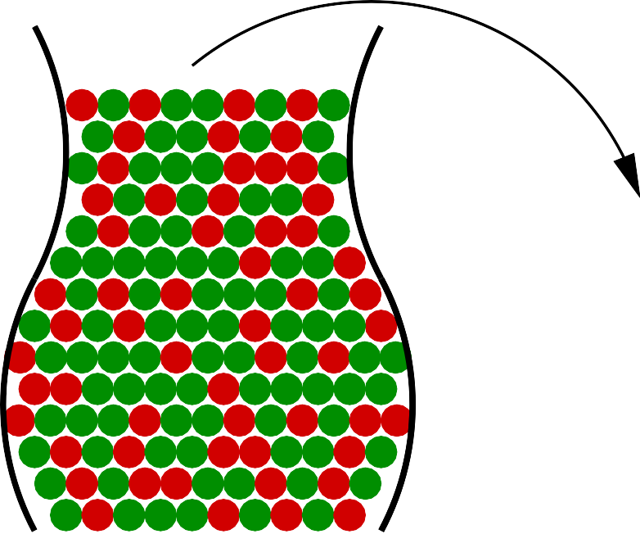







Related Experiment
- Consider a 'bin' with red and green marbles.
top
P[ picking a red marble ] = µ
B I N
P[ picking a green marble ] = 1 − µ
S A M P L E
- The value of µ is unknown to us.
ν = fraction of red marbles
- We pick N marbles independently.
μ = probability of red marbles
bottom
- The fraction of red marbles in sample = ν

Slide 14
Does ν say anything about µ?
No!
top
B I N
Sample can be mostly green while bin is mostly red.
S A M P L E
Yes!
ν = fraction of red marbles
Sample frequency ν is likely close to bin frequency µ.
μ = probability of red marbles
Possible versus
Probable
bottom

Slide 15
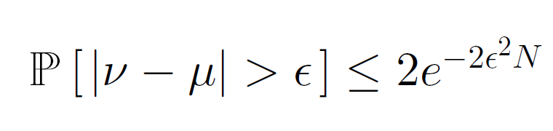
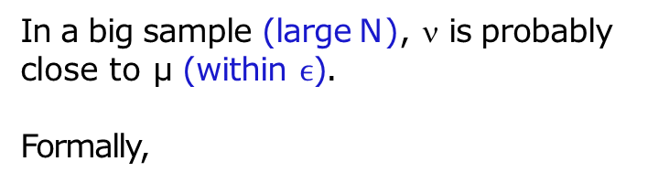
What does ν say anything about µ?
In a big sample (large N), ν is probably close to µ (within $ϵ$).
Formally,
Bad Event!
This is called Hoeffding's Inequality.
Tollerance
In other words, the statement µ = ν
is P.A.C.
Confidence

Slide 16
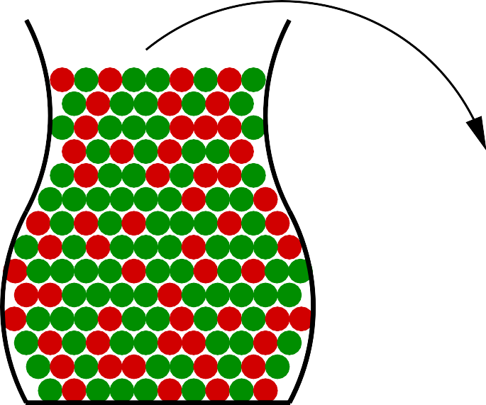








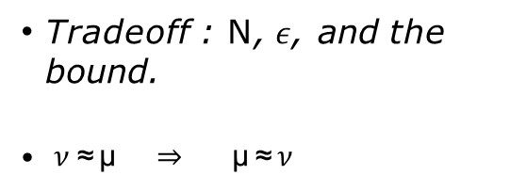
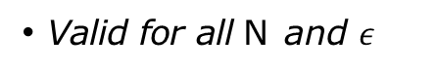
What does ν say anything about µ?
top
B I N
Valid for all N and $ε$
Bound does not depend on µ
S A M P L E
ν = fraction of red marbles
Tradeoff : N, $ε$, and the bound.
$ν$ ≈ µ ⇒ µ ≈ $ν$
μ = probability of red marbles
bottom

Slide 17
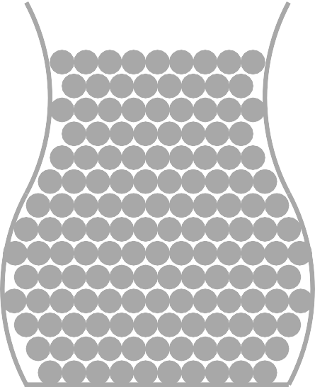
Connection to learning?
Th^{H}e^{i}
bin analogy:
UNKNOWN TARGET FUNCTION
f: X Y
PROBABILITY DISTRIBUTION
P on X
X
TRAINING EXAMPLES
(x₁ , y₁ ), ... , ( x_{N} , y_{N} )
x₁ , ... , x_{N}
LEARNING ALGORITHM A
FINAL HYPOTHESIS
g ~ f
HYPOTHESIS SET
H
Hi
§

Slide 18
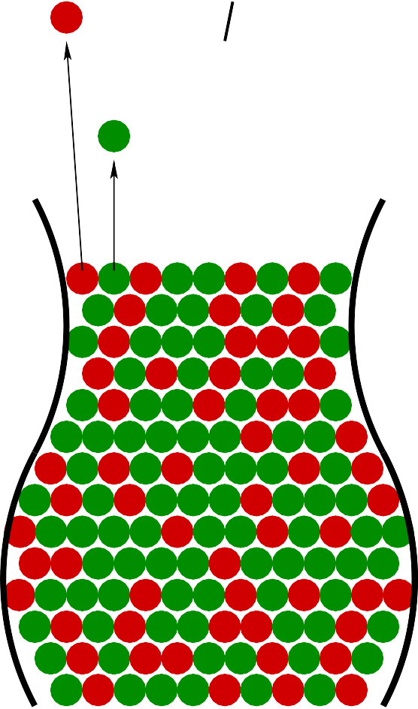
Connection to learning?
Bin: The unknown is a number µ
h(x)= f(x)
Learning: The unknown is a function f : X → Y
Each marble • is a point x∈ X
: Hypothesis got it right h(x)=f (x)
: Hypothesis got it wrong h(x) ≠ f (x)
h(x)= f(x)
Hi

Slide 19
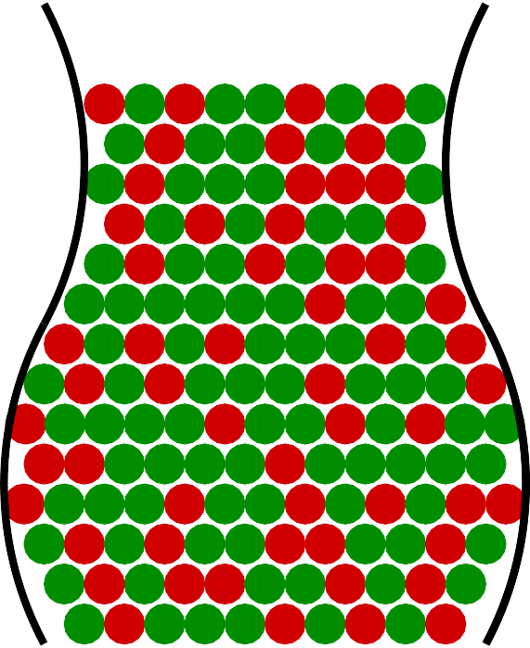
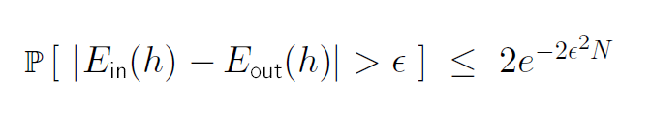



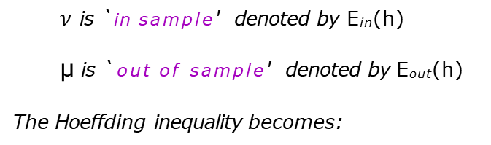
E_{out}(h)
In sample – Out of sample Error
Hi
Both µ and $ν$depend on which hypothesis h
$ν$ is `in sample' denoted by E_{in}(h)
µ is `out of sample' denoted by E_{out}(h) The Hoeffding inequality becomes:
E_{in}(h)
Hi
§

Slide 20
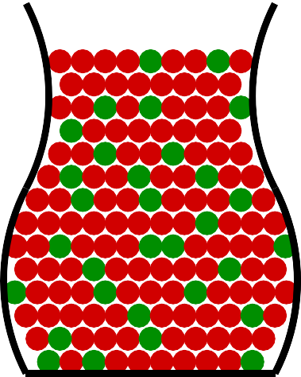
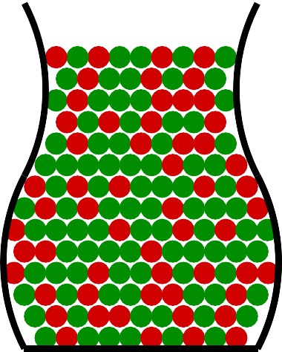
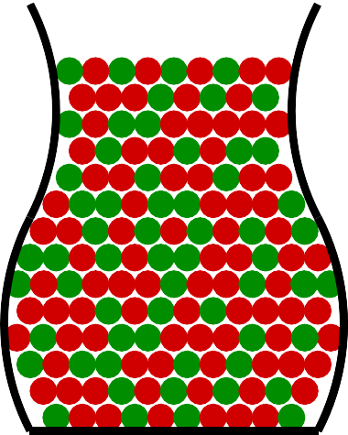
h₁ h₂
Multiple Bins
Generalizing the bin model to more than one hypothesis:
top
h_{m}
μ μ
1 2
μ
M
. . . . . . . .
ν₁
ν₂
ν_{M}
bottom
§

Slide 21
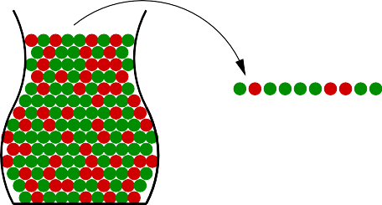
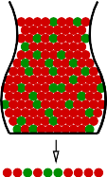
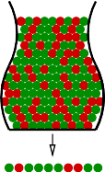
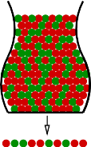
Multiple Bins
Not so fast!! Hoeffding doesn't apply to multiple bins. What?
top
UNKNOWN TARGET FUNCTION
f: X Y
PROBABILITY DISTRIBUTION
P on X
top
h₁
h₂
h_{M}
B I N
TRAINING EXAMPLES
(x₁ , y₁ ), ... , ( x_{N} , y_{N} )
S A M P L E
→
x₁ , ... , x_{N}
→
^{E}out⁽h₁⁾
^{E}out⁽h₂⁾
^{E}out⁽h_{M} ⁾
ν = fraction of red marbles
LEARNING ALGORITHM A
FINAL HYPOTHESIS
g ~ f
. . . . . . . .
μ = probability of red marbles
HYPOTHESIS SET
H
E_{in}(h₁)
E_{in}(h₂)
E_{in}(h_{M} )
bottom
bottom

Slide 22
Agenda: The Learning Theory
The Learning Problem
Is Learning Feasible
Error and Noise
Theory of Generalization
The VC Dimension
Bias-Variance Tradeoff
Overfitting

Slide 23
Question: If you toss a fair coin 10 times, what is the probability that you will get 10 heads?
Multiple Bins
Answer: ≈ 0.1%
Question: If you toss 1000 fair coins 10 times each, what is the probability that some coin will get 10 heads?
Answer: ≈ 63%

Slide 24

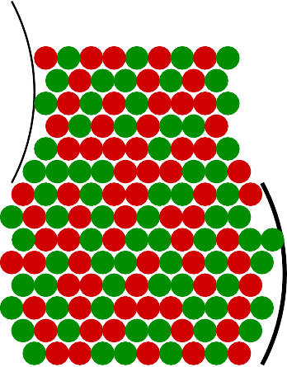


From Coins to Learning
hi
B I N G O ?
Hi
§
Notes:
here

Slide 25
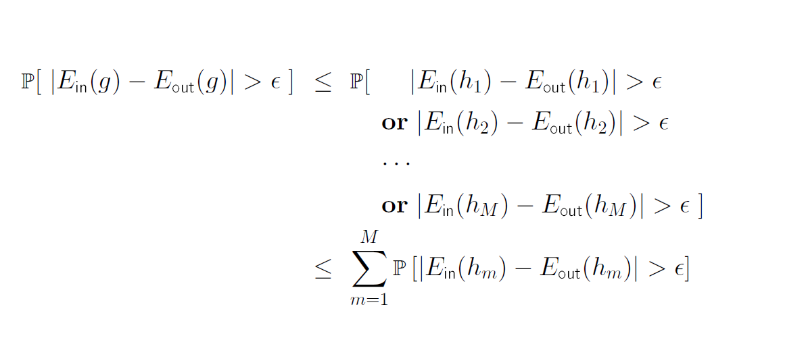
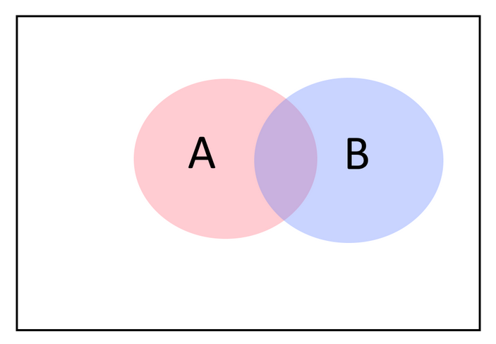
A simple Solution – Union Bound
Focus on this case!
Important afterwards
Notes:
Union Bound – second part disequation

Slide 26
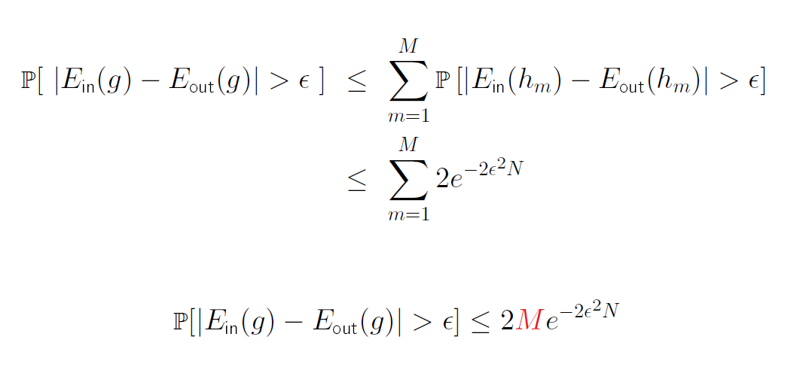
Final Verdict
STOP – Important One!

Slide 27
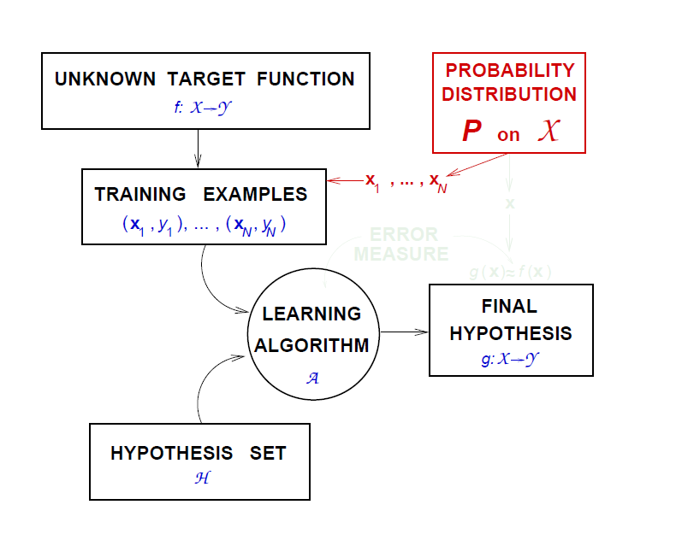
The learning Diagram – where we left it

Slide 28
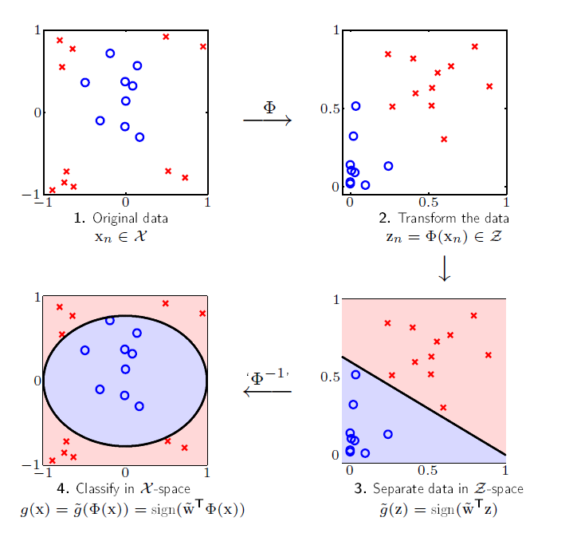
Data Distribution
§

Slide 29
Agenda: The Learning Theory
The Learning Problem
Is Learning Feasible
Error and Noise
Theory of Generalization
The VC Dimension
Bias-Variance Tradeoff
Overfitting

Slide 30
What does "h ≈ f" mean?
The learning Diagram – where we left it
Error measure: E(h, f)
Almost always pointwise definition: e(h(x), f(x))
Examples:
Squared error:
e (h(x), f (x)) = (h(x) − f(x))²
e (h(x), f (x)) = [h(x) ≠ f(x)]
Binary error:

Slide 31
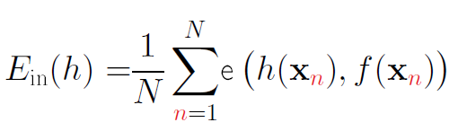
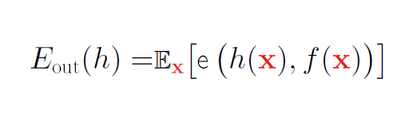
Overall error E(h, f) = average of pointwise errors
Overall Error
e(h(x), f(x))
In-sample error:
Out-of-sample error:

Slide 32
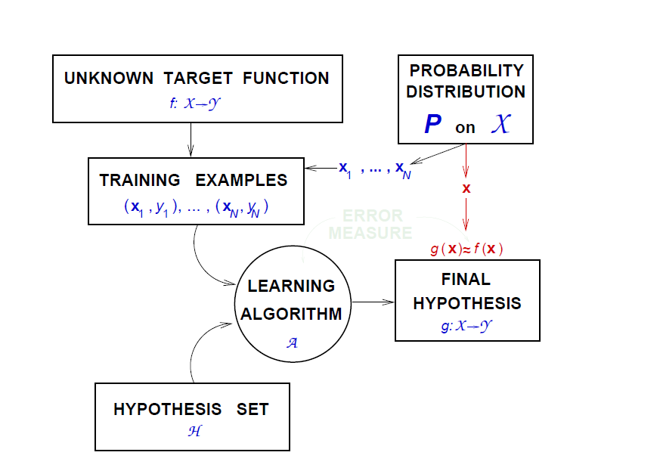
Diagram with pointwise error

Slide 33

Fingerprint Verification:
How to Choose the Error Measure
Two types of error:
false accept and false reject
+1 you
f
How do we penalize each type?
−1
intruder
f
+1
−1
+1 no error
−1 false reject
false accept no error
h

Slide 34
Supermarket verifies fingerprint for discounts
The Error Measure – In the Supermarket
False reject is mostly, customer gets annoyed!
+1 you
False accept is minor; gave away a discount and intruder left their fingerprint
f
-1
intruder
f
+1 −1
+1 0 1
−1 10 0
h

Slide 35
The Error Measure – CIA
CIA verifies fingerprint for security
False accept is a disaster!
False reject can be tolerated.
Try again, you are an employee
+1 you
f
-1
intruder
f
+1 −1
+1 0 1000
−1 1 0
h
§

Slide 36
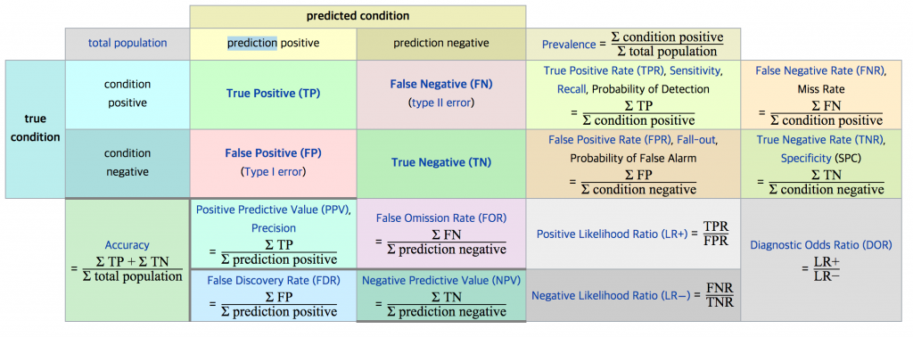
The Error Measure

Slide 37
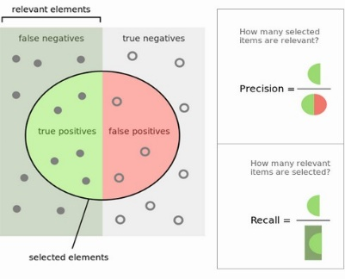
The Error Measure

Slide 38
The error measure should be specified by the user.
Take Home Lesson
Not always possible. Alternatives:
Some measures: squared error, cross entropy

Slide 39
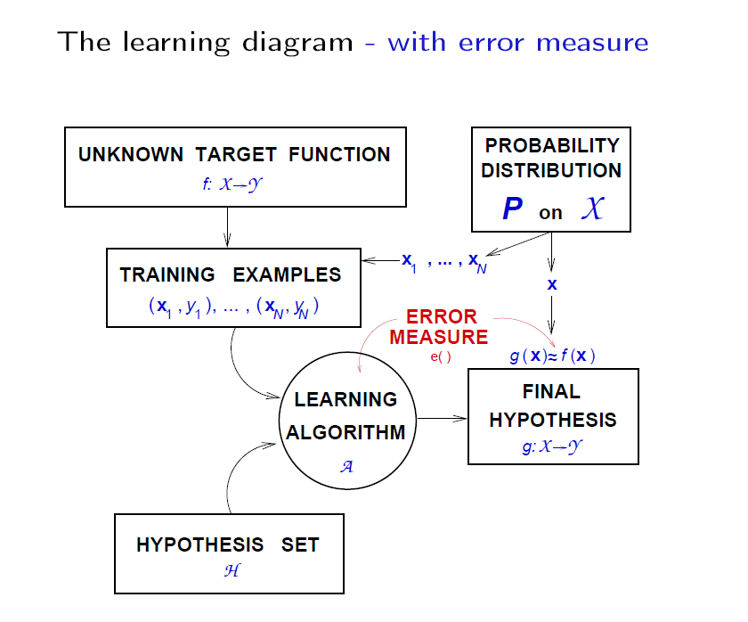
Error Measure
§

Slide 40
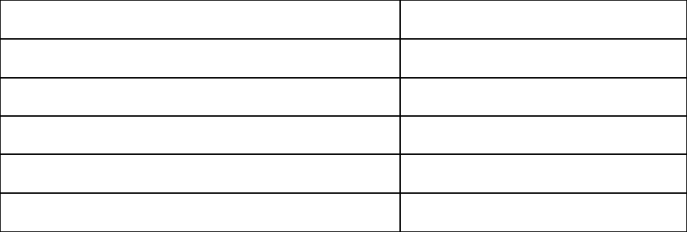
The 'target function' is not always a function
Noisy Targets
Consider the creditcard approval:
age annual salary
years in residence years in job
current debt
· · ·
23 years
$30,000
1 year
1 year
$15,000
· · ·
two 'identical' customers → two different behaviors

Slide 41
Instead of y = f(x), we use target distribution:
Target Distribution
P (y|x)
(x, y) is now generated by the joint distribution:
P (x) P (y| x)
Noisy target = deterministic target f(x) = E (y|x) plus
noise y − f (x)
Deterministic target is a special case of noisy target:
P (y | x) is zero except for y = f (x)
Notes:
here

Slide 42
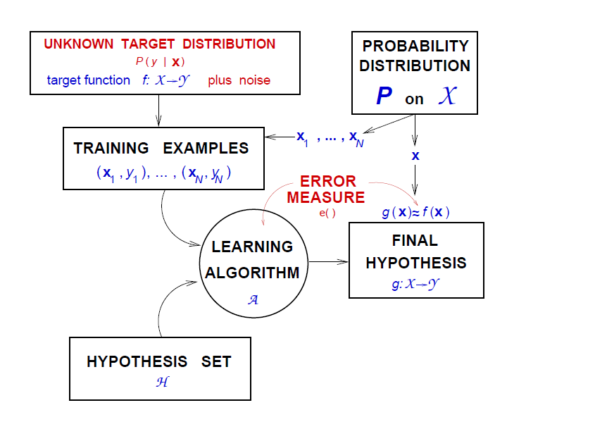
The learning Diagram + Noisy Targets

Slide 43
Agenda: The Learning Theory
The Learning Problem
Is Learning Feasible
Error and Noise
Theory of Generalization
The VC Dimension
Bias-Variance Tradeoff
Overfitting

Slide 44
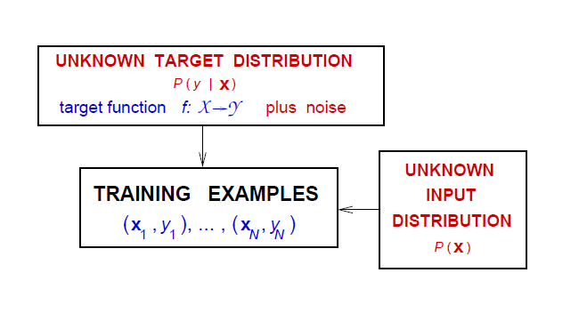
Distinction between P (y|x) and P (x)
Both convey probabilistics aspects of x and y
The target distribution P (y | x)
is what we are trying to learn
The input distribution P (x)
quantifies relative importance of x
Merging P (x)P (y | x) as P (x , y) mixes the two concepts

Slide 45
Learning is feasible. It is likely that
What we know so far
E_{out}(g) ≈ E_{in}(g)
Is this learning?
We need g ≈ f , which means
E_{out}(g) ≈ 0
§

Slide 46
E_{out}(g) ≈ 0
2 Questions of Learning
is achieved through:
E_{out}(g) ≈ E_{in}(g)
E_{in}(g) ≈ 0
and
Learning is thus split into 2 questions:
Can we make sure that E_{out}(g) is close enough to E_{in}(g)?
Can we make E_{in}(g) small enough?

Slide 47
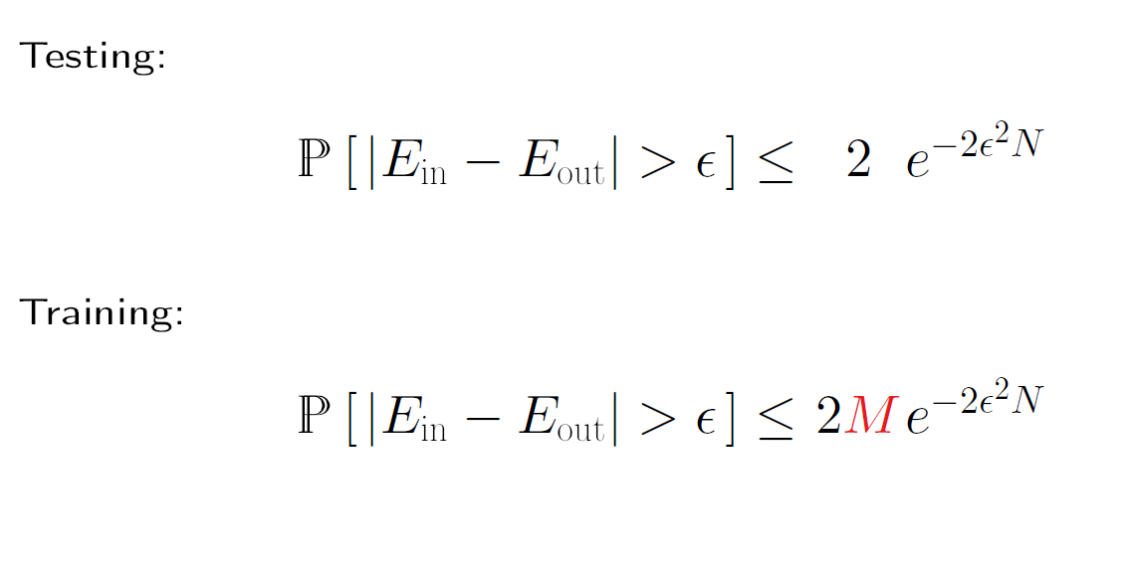
Training Setting

Slide 48
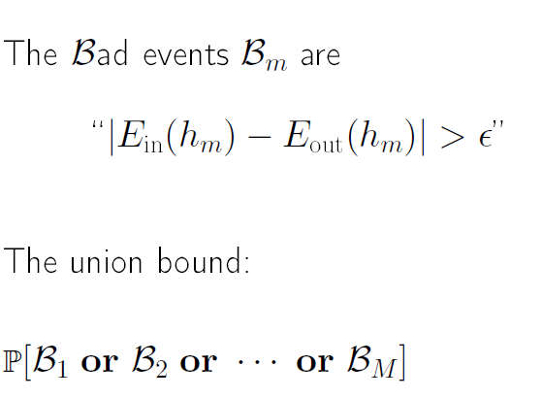
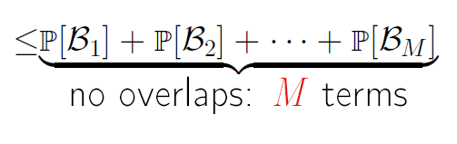
B₂
Where did M come from?
B₁
B₃

Slide 49
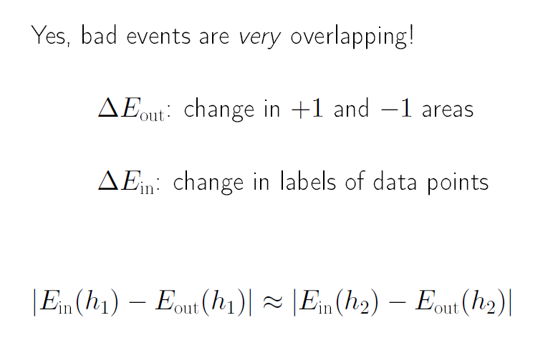
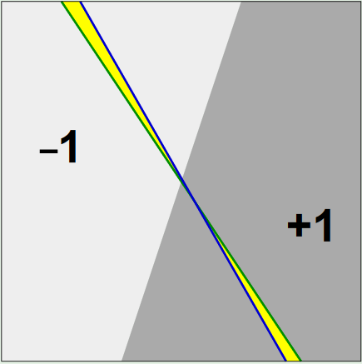
Can we improve M ?
Eout
Eout
Notes:
here

Slide 50
Can we replace M with ?
Instead of the whole input space,
we consider a finite set of input points,
and count the number of dichotomies

Slide 51
Dichotomies: mini-hypotheses
A hypothesis
h : X → {−1, +1}
A dichotomy
h : {x₁, x₂, · · · , x_{N} } → {−1, +1}
Number of hypotheses |H| can be infinite
Number of dichotomies |H(x₁, x₂, · · · , x_{N} )| is at most 2^{N}
Candidate for replacing M

Slide 52
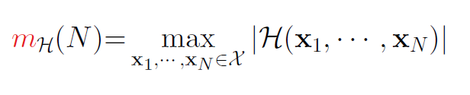
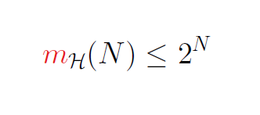
The growth function
The growth function counts the most dichotomies on any N points
The growth function satisfies:
Let's apply the definition.

Slide 53





Applying mH(N ) definition - perceptrons
N = 3
N = 3
N = 4
m_{H}(3) = 8
m_{H}(4) =14
§

Slide 54

h(x) = −1
Positive Rays
h(x) = +1
a
x₁ x₂ x₃ . . .
x_{N}
H is set of h : R → {−1, +1}
h(x) = sign(x − a) m_{H}(N ) = N + 1
§
Notes:
here

Slide 55


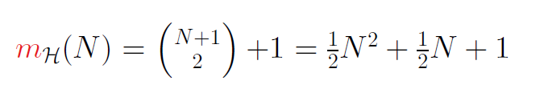
h(x) = −1
Positive Intervals
h(x) = +1
h(x) = −1
x₁ x₂ x₃ . . .
x_{N}
H is set of h : R → {−1, +1}
Place interval ends in two of N + 1 spots
Notes:
here

Slide 56
Convex sets
H is set of
h : R² → {−1, +1}
h(x) = +1 is convex
up
+
−
+
+
−
−
m_{H}(N ) = 2^{N}
−
The N points are 'shattered' by convex sets
+
−
+
bottom

Slide 57
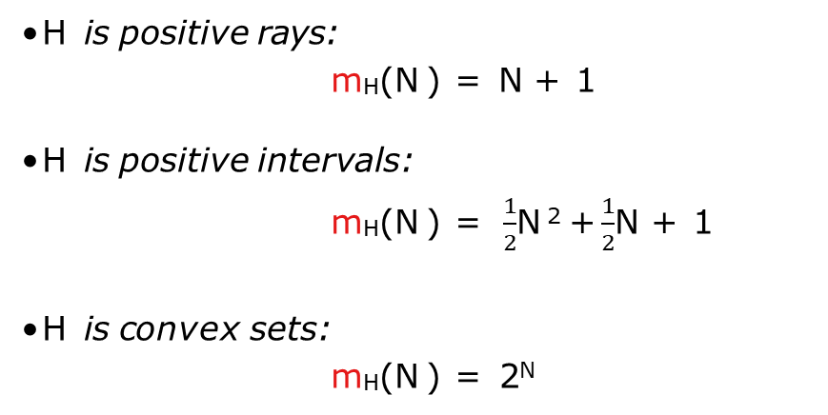
The 3 growth functions
H is positive rays:
m_{H}(N ) = N + 1
H is positive intervals:
m_{H}(N ) = $\frac{1}{2}$N ² +$\frac{1}{2}$N + 1
H is convex sets:
m_{H}(N ) = 2^{N}

Slide 58
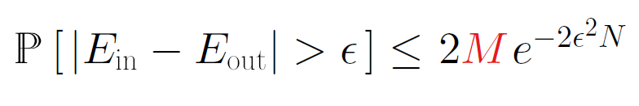
Back to the big picture
Remember this inequality?
What happens if m_{H}(N ) replaces M ?
m_{H}(N ) polynomial ⇒
Good!
Just prove that m_{H}(N ) is polynomial?

Slide 59
Breakpoint of H
Definition:
If no data set of size k can be shattered by H, then k is a break point for H
m_{H}(k) < 2^{k}
For 2D perceptrons, k = 4
A bigger data set cannot be shattered either

Slide 60
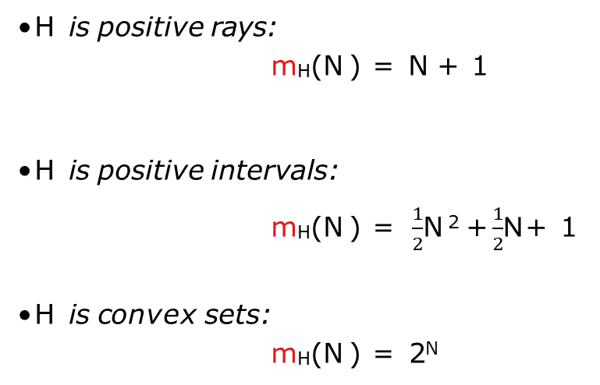
Breakpoints, 3 Examples
H is positive rays:
m_{H}(N ) = N + 1
H is positive intervals:
m_{H}(N ) = $\frac{1}{2}$N ² +$\frac{1}{2}$N + 1
H is convex sets:
m_{H}(N ) = 2^{N}
break point k = 2
• •
break point k = 3
• • •
break point k =`∞'

Slide 61
⇒ m_{H}(N ) = 2^{N}
Main Result
No break point
⇒
m_{H}(N) is polynomial in N
Any break point

Slide 62
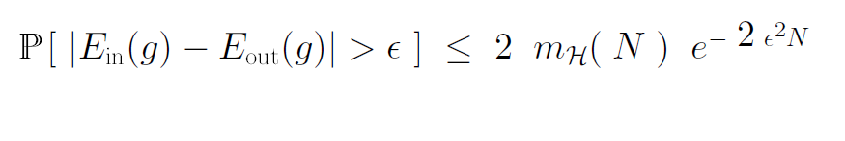
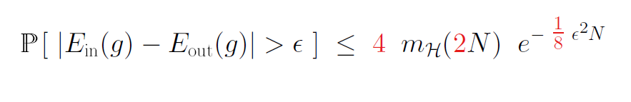
Putting it altogether
Not quite:
But more:
The Vapnik-Chervonenkis Inequality

Slide 63
Agenda: The Learning Theory
The Learning Problem
Is Learning Feasible
Error and Noise
Theory of Generalization
The VC Dimension
Bias-Variance Tradeoff
Overfitting

Slide 64
Definition of VC dimensions
The VC dimension of a hypothesis set H, denoted by d_{vc} (H), is the largest value of N for which
m_{H}(N) = 2^{N}
the most points H can shatter
N ≤ d_{vc} (H)
⇒ H can shatter N points
⇒ k is a break point for H
k > d_{vc} (H)

Slide 65
Examples
•
H is positive rays:
d_{vc}
= 1
•
H is 2D perceptrons:
d_{vc}
= 3
• •
up
H is convex sets:
d_{vc}
= ∞
bottom

Slide 66
(H) is finite ⇒ g ∈ H will generalize
VC Dimensions and Learning
d_{vc}
up
UNKNOWN TARGET FUNCTION
f: X Y
PROBABILITY DISTRIBUTION
P on X
Independent of the learning algorithm
TRAINING EXAMPLES
(x₁ , y₁ ), ... , ( x_{N} , y_{N} )
Independent of the input distribution
LEARNING ALGORITHM A
FINAL HYPOTHESIS
g ~ f
HYPOTHESIS SET
H
Independent of the target function
down

Slide 67

Degrees of Freedom
Parameters create degrees of freedom
# of parameters: analog degrees of freedom
: equivalent ' binary' degrees of freedom
d_{vc}

Slide 68
Not just parameters
Parameters may not contribute degrees of freedom:
down
x
y
down
d_{vc}
measures the effective number of parameters

Slide 69
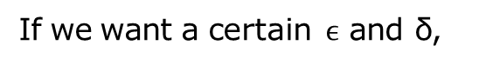
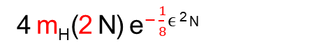
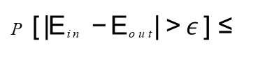
Two small quantities in the VC inequality:
Number of Datapoints needed
P [ |E_{in} − E_{out}| > $ε$ ] ≤
_{4 mH (2 N) e} − $\frac{1 }{8}$ $ϵ$² N
δ
d_{vc}
If we want a certain $ϵ$ and δ,
how does N depend on ?
Let us look at
_{N} d_{e}−N

Slide 70

Visual Representation
Fix N ^{d} e ^{− N} = small value
₁₀10
How does N change with d?
_{N} 30_{e}−N
10⁵
10⁰
Rule of thumb:
₁₀−5
N ≥ 10 d_{vc}
20
40
60
80
100
120
140
160
180
200
§

Slide 71
Agenda: The Learning Theory
The Learning Problem
Is Learning Feasible
Error and Noise
Theory of Generalization
The VC Dimension
Bias-Variance Tradeoff
Overfitting

Slide 72



Start from the VC inequality:
Rearranging Things
Get $ϵ$ in terms of δ:
With probability ≥ 1 − δ,
|E_{out} − E_{in}| ≤ Ω(N, H, δ)

Slide 73


With probability ≥ 1 − δ,
Generalization Bound
⇒
With probability ≥ 1 − δ,

Slide 74
With probability ≥ 1 − δ,
Generalization Bound
⇒
With probability ≥ 1 − δ,
Subject of Regularization

Slide 75
Approximation and Generalization Tradeoff
Small E_{out}: good approximation of f out of sample.
More complex H ⇒ better chance of approximating f
Less complex H ⇒ better chance of generalizing out of sample
Ideal H = {f}
Chances of winning lottery ticket

Slide 76
Quantifiying the Tradeoff
VC analysis was one approach: E_{out} ≤ E_{in} + Ω
Bias-variance analysis is another: decomposing E_{out} into
How well H can approximate f
How well we can zoom in on a good h ∈ H
Applies to real-valued targets and uses squared error

Slide 77



Starting with Eout
To evaluate:
We compute the ' average' hypothesis g ¯(x):
§

Slide 78

Bias and Variance

Slide 79

The Tradeoff
Take Expectation with respect to x, and obtain bias and variance
↓
H ↑
↑
§

Slide 80
Example: Sine Target
f : [−1, 1]→ R f (x) = sin(πx)
Only two training examples!
N = 2
f
2
1.5
1
Two models used for learning:
0.5
H₀: h(x) = b
H₁: h(x) = ax + b
0
−0.5
−1
−1.5
Which is better, H₀ or H₁?
−2
−1
−0.8
−0.6
−0.4
−0.2
0
0.2
0.4
0.6
0.8
1

Slide 81

Approximation
H₀ versus H₁
H₀
H₁
2
2
1.5
1.5
1
1
0.5
0.5
0
0
−0.5
−0.5
−1
= 0.50
−1
= 0.20
−1.5
Eout
−1.5
Eout
−2
−2
−1
−0.8
−0.6
−0.4
−0.2
0
0.2
0.4
0.6
0.8
1
−1
−0.8
−0.6
−0.4
−0.2
0
0.2
0.4
0.6
0.8
1

Slide 82
Learning
H₀ versus H₁
H₀
H₁
2
2
1.5
1.5
1
1
0.5
0.5
0
0
−0.5
−0.5
−1
−1
−1.5
−1.5
−2
−2
−1
−0.8
−0.6
−0.4
−0.2
0
0.2
0.4
0.6
0.8
1
−1
−0.8
−0.6
−0.4
−0.2
0
0.2
0.4
0.6
0.8
1

Slide 83
Bias and Variance
y
y
g¯(x)
sin(πx)
x
x
§

Slide 84



Bias and Variance – H1
g¯(x)
sin(πx)
y
y
x
x
§

Slide 85
And the winner is
H₀
H₁
g¯(x)
y
g¯(x)
y
sin(πx)
sin(πx)
x
x
bias = 0.50
var = 0.25
bias = 0.21
var = 1.69

Slide 86
Agenda: The Learning Theory
The Learning Problem
Is Learning Feasible
Error and Noise
Theory of Generalization
The VC Dimension
Bias-Variance Tradeoff
Overfitting

Slide 87
Lesson Learned
Match the 'model complexity'
to the data resources, not to the target complexity

Slide 88
Expected Eout and Ein
Data set D of size N
Expected out-of-sample error
E_{D}[E_{out}(g^{(D)})]
Expected in-sample error
E_{D}[E_{in}(g^{(D)})]
How do they vary with N ?

Slide 89
Eout
The curves
Expcted Error
Expeted Error
Ein
E
out
Ein
Number of Data Points, N
Number of Data Points, N
Simple Model
Complex Model
§

Slide 90
Characterizing the feasibility of learning for infinite M
What the Theory will achieve
out-of-sample error
Error
model complexity
Characterizing the tradeoff :
Model complexity ↑
Model complexity ↑
Ein
Eout− Ein
↓
↑
in-sample error
d
∗
v
VC dimension, d_{v}
§

Slide 91
Sources
https://work.caltech.edu/telecourse.html
http://gruber.userweb.mwn.de/17.18.statlearn/17.18.statlearn.html

